Slide 1

Design and Analysis of Algorithms
Instructor: Muhammad Arif Shah

Slide 2
Lecture No 2
2-Dimensional Maxima

Slide 3
Review of Lecture No 1
Introduction to Algorithms
Designing Techniques
Model of Computation
Even we have supercomputers, it requires algorithm
Algorithms makes difference in users and modeler
Some of the applications areas of algorithms
  Management and manipulation of data
  Electronic commerce
  Manufacturing and other commercial settings
  Shortest paths etc.

Slide 4
2-Dimensional Maxima
2-dimensional Maxima:
  Given a set of points P= {p1, p2, …, pn} in 2-dimensional space
  Output the set of maximal points of P, i.e. those points pi such that pi is not dominated by any other point of P.

Slide 5
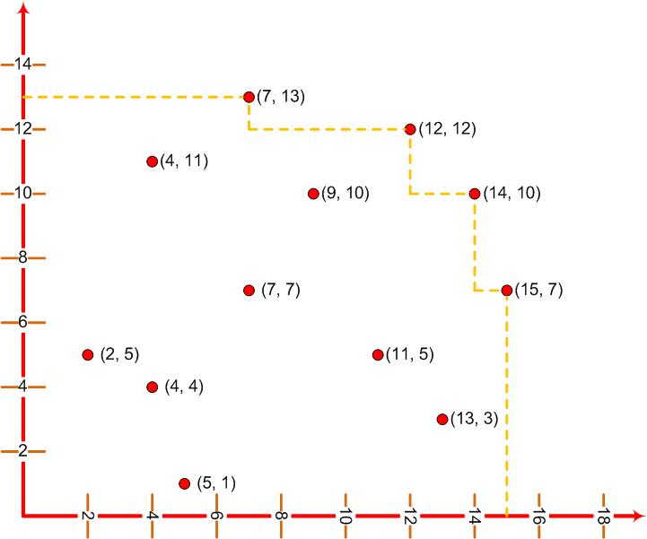
2-Dimensional Maxima

Slide 6
2-Dimensional Maxima
Our description of the problem is at a fairly mathematical level
We have intentionally not discussed how the points were represented
We have not discussed any input or output formats
We have avoided programming and other software issues

Slide 7
2-Dimensional Maxima
Let P= {p₁, p₂, …, p_{n}} be the initial set of points
For each point p_{i}, test it against all other points p_{j}
If p_{i} is not dominated by any other point, then output it

Slide 8
2-Dimensional Maxima: Brute Force Algorithm
MAXIMA(int n, Point P[1….n])
for i 1 to n
do maximal true
for j 1 to n
do
if(i≠ j) and (P[i].x ≤ p[j].x) and (P[i].y ≤ p[j].y)
then maximal false; break
if (maximal = true)
then output P[i]

Slide 9
Analysis
Running Time Analysis
  The main purpose of our mathematical analysis will be measuring the execution time.
Space Utilization Analysis
To measure the running time of the brute-force 2-dimension maxima algorithm, we could
  Count the number of steps of the pseudo code that are executed
  Count the number of times an element of P is accessed
  Count the number of comparisons that are performed

Slide 10
Analysis
The running time depends on the input size, e.g. n
Different inputs of the same size may result in different running time
For example,
  Breaking out of the inner loop in the brute-force algorithm depends not only on the input size of P but also the structure of the input

Slide 11
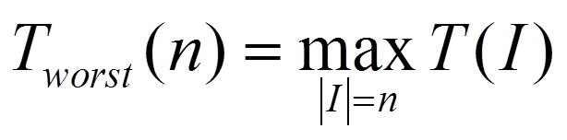
Analysis Criteria
Worst-Case Time
  Worst-case time is the maximum running time over all (legal) inputs of size n
Definition
  Let I denote an input instance
  Let |I| denote its length, and
  Let T(I) denote the running time of algorithm on input I
  Then
  T(n) is the maximum number of basic operations performed by the algorithm on any input of size n.

Slide 12
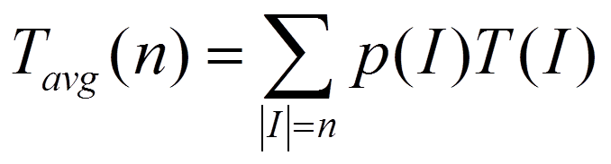
Analysis Criteria
Average-Case Time
  Average-case time is the average running time over all inputs of size n.
Definition
  Let p(I) denote the probability of seeing this input
  The average-case time is the weighted sum of running times with weights being the probabilities.

Slide 13
Analysis Criteria
We will almost always work with worst-case time
Average-case time is more difficult to compute; it is difficult to specify probability distribution on inputs
Worst-case time will specify an upper limit on the running time

Slide 14
Analysis of 2-Dimensional Maxima
Analysis of the brute-force maxima algorithm
  Input size is n
  We will count the number of times that any element of P is accessed

Slide 15
Analysis of 2-Dimensional Maxima
MAXIMA(int n, Point P[1….n])
for i 1 to n
do maximal true
for j 1 to n
do
if(i≠ j) and (P[i].x ≤ p[j].x) and (P[i].y ≤ p[j].y)
then maximal false; break
if (maximal = true)
then output P[i].x, P[i].y
n times
n times
4 accesses
The outer loop runs n times
For each i iteration, the inner loop runs n times
P is accessed four times in the if statement
The output statement accesses P two times
In the Worst-case, every point is maximal, So every point is output
2 accesses

Slide 16
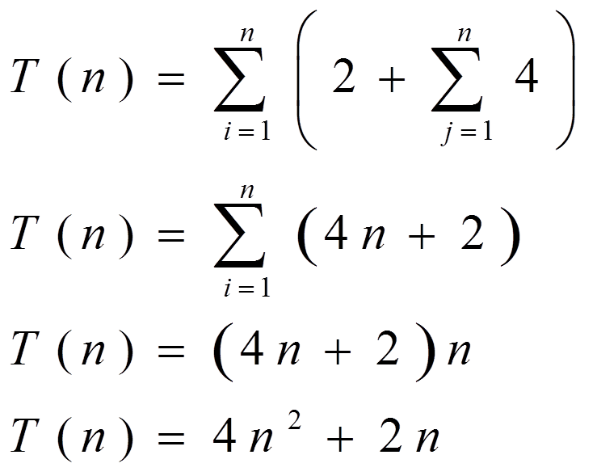
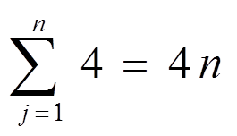
Worst Case Running Time
Pair of nested summations, one for i-loop and the other for the j-loop.

